Slide 1

DXC Luxoft India An Overview
January 2026

Slide 2





Our Purpose, Mission and Values Strategy
Purpose
Delivering excellence for our customers and colleagues
Mission
Be an IT services company using the power of technology to build better futures for our customers, colleagues, environment and communities, helping our customers deliver business impact, and be the employer of choice
Our Values
Deliver ... We do what we say we are going to do.
Care ... We take care of each other and foster a culture of inclusion and belonging.
Collaborate ... We work as a team – globally and locally.
Do the right thing … We act with integrity.
Community ... We believe in stewardship and building a sustainable company that supports our communities.
Notes:
Purpose
Delivering excellence for our customers and colleagues
Mission
Be an IT services company using the power of technology to build better futures for our customers, colleagues, environment and communities, helping our customers deliver business impact, and be the employer of choice.
Our Values
Deliver ... We do what we say we are going to do.
Big or small, we follow through on what we promise and deliver with dedication and expertise to delight our customers and earn their trust. Our mission critical technologies help our customers transform today and innovate for tomorrow.
Collaborate ... We work as a team – globally and locally.
We are a global team of highly specialized and talented people innovating together. We inspire and support each other so we can deliver excellence for our customers. When we innovate, we grow.
Community ... We believe in stewardship and building a sustainable company that supports our communities.
We are committed to improving our company, customers and communities through technology, innovation and best practices with a focus on our Environmental, Social, Governance (ESG) initiatives to advance the sustainability of our operations and foster equity, inclusion and diversity in all elements of our business.
Care ... We take care of each other and foster a culture of inclusion and belonging.
We foster a culture of inclusion and caring for each other. Our people are smart, talented, and embrace diversity to create an environment where everyone can reach their full potential.
Do the right thing … We act with integrity.
We do the right thing. We act with integrity and treat everyone with respect. Our work ensures the success, safety and well-being of millions of people and communities worldwide.
Every day we Deliver eXcellence for our Customers and Colleagues. Our mission-critical IT services make our customers successful. Our commitment to stewardship and sustainability fosters community and a workforce that takes care of each other. We are DXC.

Slide 3

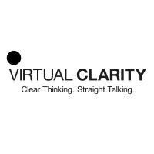






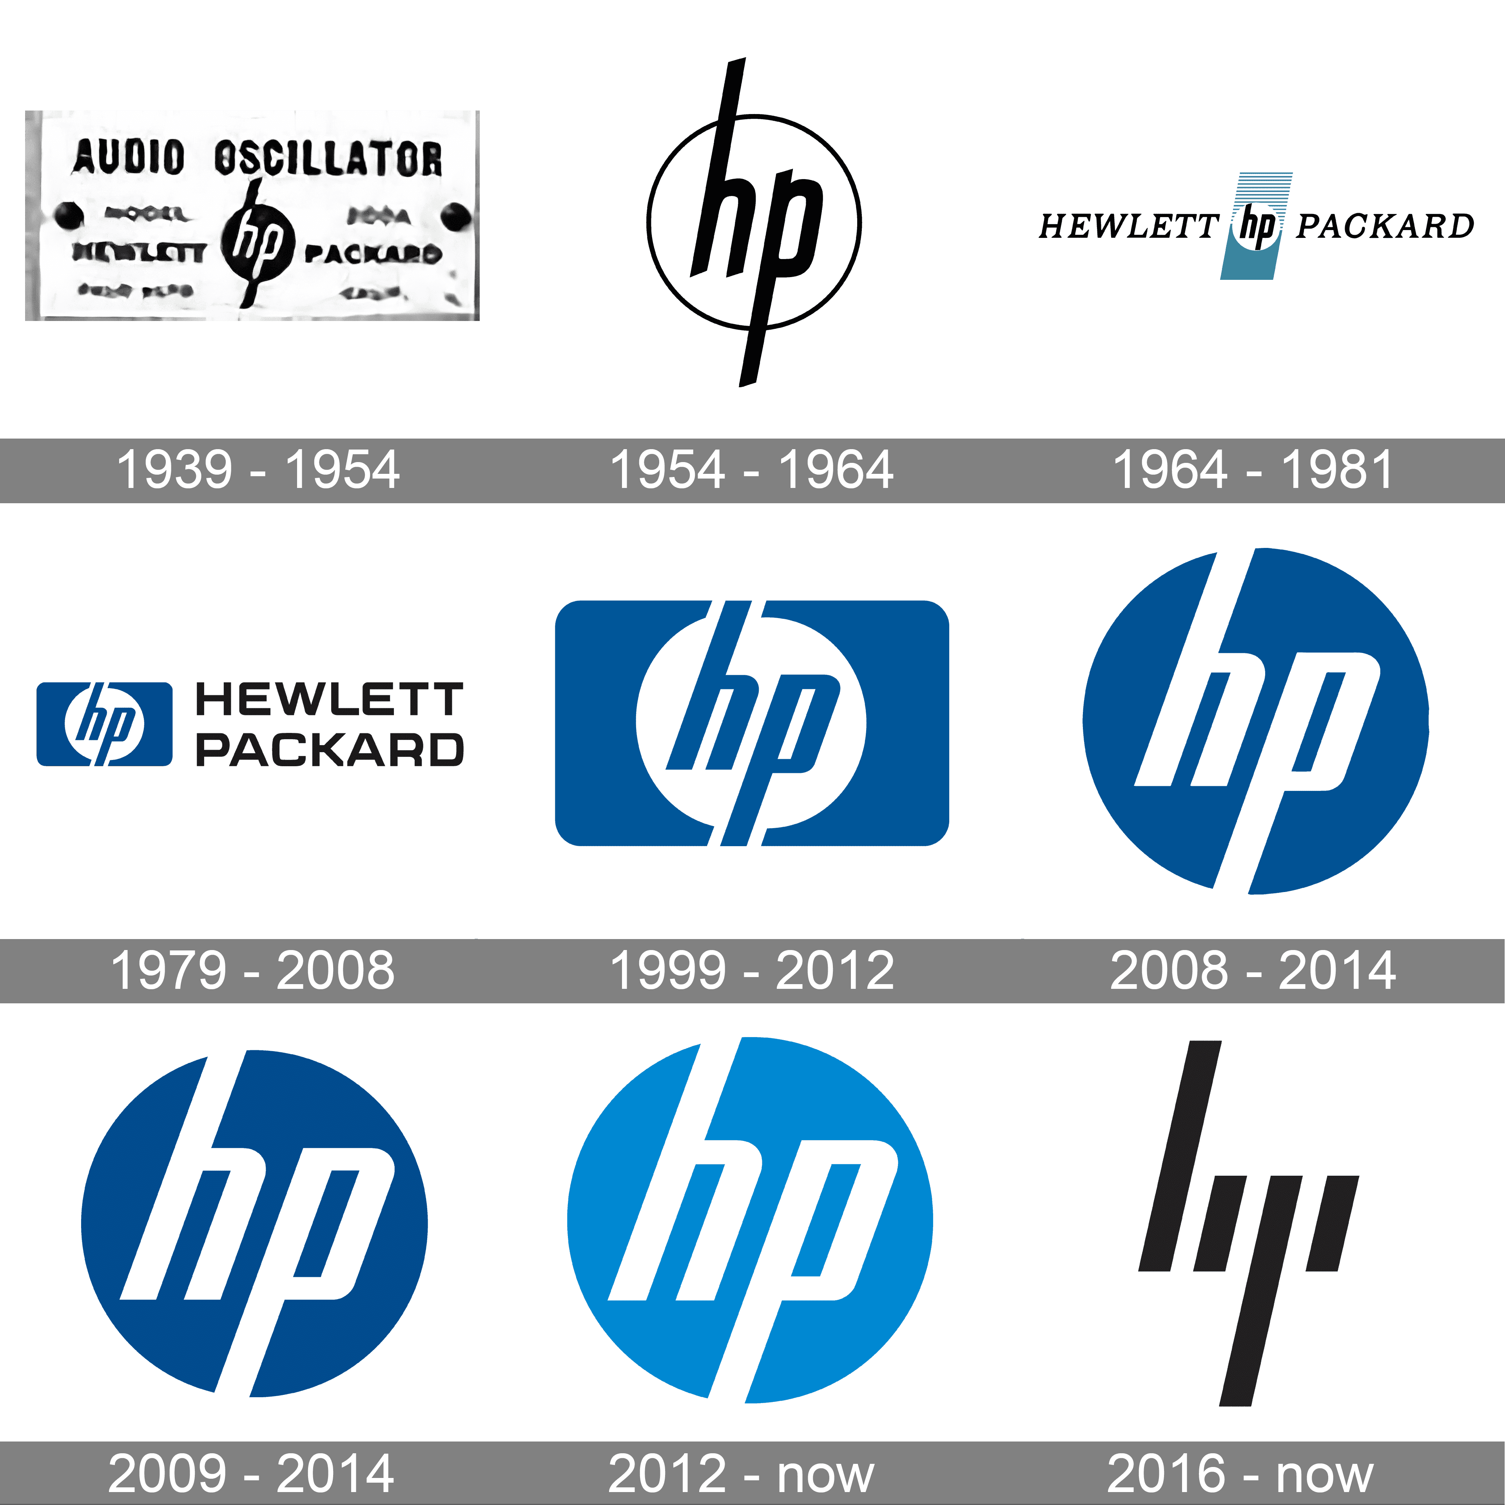





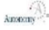

DXC Technology Company History DXC Technology has over 60 years of service and track record, integrated with service division of HP / DEC / COMPAQ / TANDEM / EDS / EDS / CSC
2000
2008
1959
IT Service
1962
2008
1999
2016
IT Outsourcing
1982
Application / Solution Dev.
1974
1997
1998
2002
HPE ES spin-off & CSC Merger
1957
2002
2017
2019
2020
1939
Server / Storage
1980
1989
2015
Network devices
1979
2009
2017
Software
1992
2010
2011
2016
PC / mobile
1996
Printing
2005
2011
Notes:
Our History and how we developed across the years
Here we can see growth in four dimensions
Locations from start until now
Line of businesses
Acquisitions or acquired companies and merges
And also how we grow from headcount across the years
Locations
We started on Russia
Then we continued in US
Then UK
Then Ukraine
Then Switzerland where is our HQ
And this year we can see 7 new locations opened Serbia, Turkey, Egypt, Portugal, Spain, Brazil Argentina
Also worth mentioning is that at the start of 2019,
We were acquired by DXC and
became a daughter company of DXC
however, Luxoft still operates with its name, identity, and own culture.

Slide 4
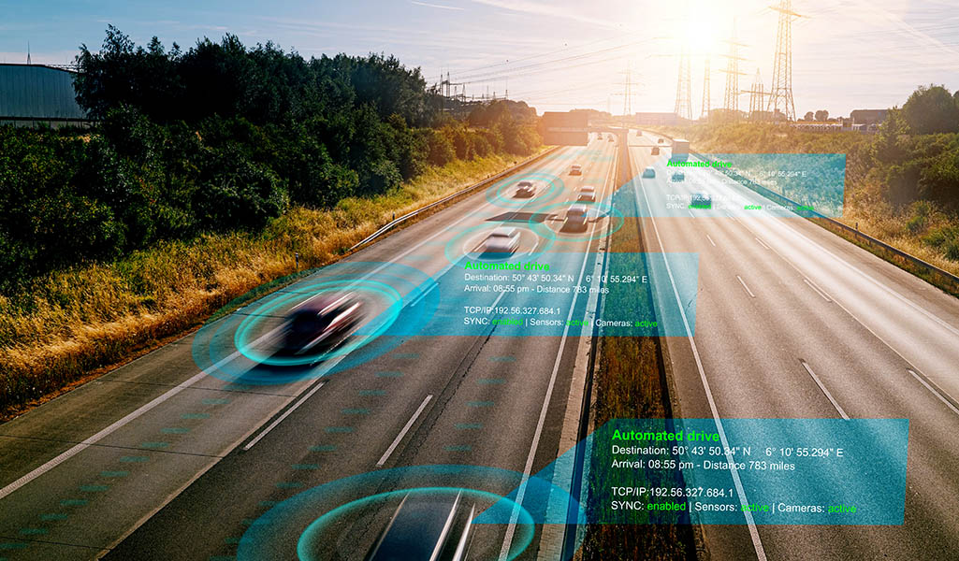
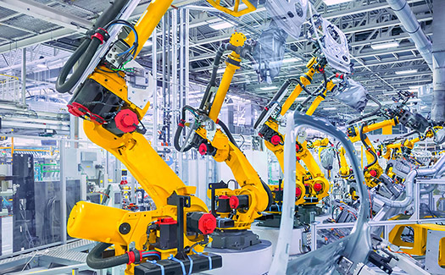






Serving customers around the world in diverse industries
Insurance
Healthcare
Life Sciences
Consumer
Retail
Travel
Energy
Transportation
Hospitality
Banking
Capital Markets
Aerospace
Defense
Utilities
Oil & Gas
Manufacturing
Automotive
Public Sector
Technology
Media
Telecom

Slide 5
DXC and Luxoft Footprint Global
Sweden
Norway
Finland
United Kingdom
7.1k
Denmark
Lithuania
Ireland
Netherlands
Slovakia
Poland
Germany
2.0k
1.9k
Belgium
1.9k
1.2k
Ukraine
3.0k
Luxembourg
France
2.1k
USA
2.0k
Czech Republic
1.6k
Switzerland
Romania
1.0k
Austria
Serbia
Bulgaria
Canada
Portugal
Spain
Hungary
3.8k
8.7k
Croatia
Italy
3.2k
Greece
62
Countries
9.9k
Türkiye
South Korea
20,670 Americas
USA
China
2.4k
1.7k
Japan
Morocco
1.3k
Tunisia
Israel
Qatar
131,780
Employees
47,860 EMEA
172
Cities
1.6k
Egypt
UAE
Hong Kong
Taiwan
63,080 APAC
Mexico
Saudi Arabia
India
1.1k
37.7k
1.2k
7.8k
170 Other Global Locations
Costa Rica
2.5k
Thailand
Vietnam
Philippines
131,780
Employees
116,200 DXC
Panama
Nigeria
Malaysia
Brunei Darussalam
Headcount is provided for locations with 1,000+ employees
Colombia
2.0k
DXC Headcount
15,580 Luxoft
2.7k
Singapore
Luxoft Headcount
DXC
61 Countries
Brazil
Indonesia
1. HC and # of countries and cities are as of January 2025 2. HC numbers include onsite, offsite, virtual employees and are rounded 3. Total countries and cities count includes unified locations of DXC and Luxoft presence 4. Countries and cities count includes locations with registered LE only 5. City count is only for delivery centers-offices, excludes other DXC building type properties 6. Other global locations include contractors and hired through PEO in locations with no LE presence
Peru
156 Cities
4.5k
Luxoft
28 Countries
Australia
51 Cities
Argentina
South Africa
Chile
New Zealand

Slide 6





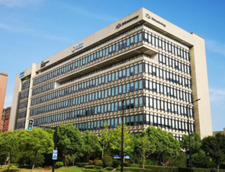


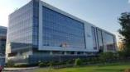
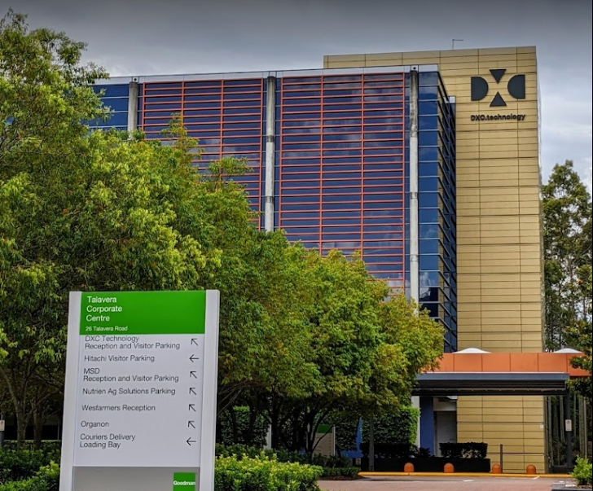

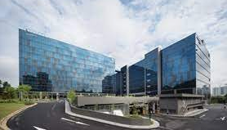


Luxoft APAC
Note: Headcount data as of April 2023 and rounded
Note: Headcount data as of April 2025 and rounded
8
1
LUXOFT REGION VALUE PROPOSITION
15
3,320
Luxoft HC
21
Total HC
Luxoft HC
A high-quality and flexible delivery model based on APAC’s expertise, scalability, and location diversity
Australia, Singapore, South Korea, China, Hong Kong (SAR) – client facing locations
India, Malaysia, Vietnam – offshore / nearshore delivery locations:
India offers value in terms of scalability potential, cost, IT pool size and diversity
Malaysia is attractive for IT experts relocating from CEE & APAC for a quality expat lifestyle
7
2
145
7
China
1
South Korea
49
Luxoft HC
6
Luxoft HC
India
8
Hong Kong (SAR)
2
Vietnam
Malaysia
4
KEY CLIENT’S HEADCOUNT
KEY CLIENT’S HEADCOUNT
6
Singapore
5
3
2,486
174
Banking & Capital Markets
1 980
Luxoft HC
Luxoft HC
Automotive
3
Australia
Technology, Media & Telecoms
Consumer & Retail
Healthcare & Life Sciences
Other industries
5
4
295
GDC & RDC Locations
IDC & Registration Locations
135
Energy, Manufacturing & Utilities
Luxoft HC
Luxoft HC

Slide 7

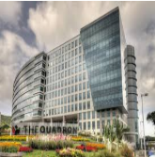
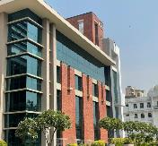
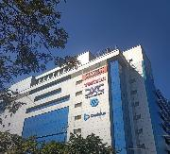
India: Location Key Facts
Note: Headcount data as of April 2025 and rounded, hiring capacity projected till June 2025
2,486
Employees
142
Clients
17
Years on the Market
160+
Hiring Capacity (Monthly)
LOCATION VALUE PROPOSITION
Is the world’s leading offshore destination, accounting for ~60% of global export IT delivery headcount
Superior value proposition in terms of cost competitiveness and a scalable IT pool for mainstream skills
Market scale supports the setting up of the Centers of Competence
Lower total cost location in Luxoft (for mainstream skills)
Is best suitable for projects requiring scale of mainstream skills
Bangalore is India’s tech hub, which hosts most tech startups and offers a wide breadth of niche skills where our main office is located. Have established office in Pune and new locations like Chennai, Noida are in discussion to have our office space
Luxoft’s strategy in India is to extend its European-managed, high-quality delivery model for its APAC clients, who demand premium services, and also act as an Offshore location for US / Europe customers
3
Noida
2
1
2
LUXOFT CORE OFFERINGS
Pune
Industries
3
4
Automotive
AD/ADAS Functions
Advanced Diagnostics
Automotive IVI
Connected Vehicle Platform
Connected Vehicle Testing
In-vehicle Platforms
Sensor-System Validation
Software Factory
Telecom, Networking, Technology & Media
Oil & Gas
Geosciences
Drilling
Cementing
Wireline and Perforating
Production
OSDU
Travel & Transportation
Track and Trace Solutions
Public Transport Apps
Airline Modernization
Supply Chain Risk Management
Customer Service Solutions
Consumer Goods & Retail
Omnichannel Composable Commerce adoption
Marketing and Branding
Industry 4.0 adoption
Digitalization and personalization
Supply Chain automation
Gamification in Retail
Bangalore
1
 | IT Labor pool | IT Graduates * | Luxoft employees
Bangalore | 561,300 | 17,750 | 1,656
Pune | 264,400 | 33,630 | 290
Noida | 85,800 | 44,620 | 100
Chennai | 192,300 | 26,480 | 210
Other India | - | - | 230
Total HC | 3,2 mln | 264,400 | 2,486
Service and Network Management
Data Center and Networking Management and Orchestration
Unified Communications
Network & Technology Solutions
Software-Defined Connectivity
Embedded Platforms
Media Content Delivery Services
Interactive Media Experience
4
Chennai
Luxoft in location:
Luxoft started operations in 2017 after the acquisition of DerivIT, which had been operational since 2008
Well-established Luxoft support system: all corporate functions’ representatives in location
Locally based relocation support
Healthcare & Life Sciences
Medical Devices Software Development
Medical Platforms consolidation & modernization
Payors digitalization & modernization
Pharma and Biotech systems implementation
Regulatory compliance
Financial Services
Core Banking solutions
Trading & Risk solutions
Client Lifecycle Management
Wealth Management solutions
Treasury solutions
Insurance
Technology Advisory
*IT graduates are based on provinces: Bangalore - Karnataka, Pune - Maharashtra, Noida - Utter Pradesh, Chennai - Tamil Nadu
Technology Solutions
Design
Cloud Solutions
Data Analytics
QA Automation
Legacy Modernization
Engineering
Intelligent Automation

Slide 8


Luxoft Global Capabilities
83% of headcount in 8 largest locations
Engineering Roles: Global Overview
Ukraine
India
Romania
Poland
Serbia
Germany
USA
Mexico
6 Core Verticals
Banking & Capital Markets
Technology, Media & Telecoms
Automotive
~17.6k
Employees
Consumer & Retail
Healthcare & Life Sciences
Energy, Manufacturing & Utilities
Including Admin staff as of Mar 2023

Slide 9

4 - Talent Building
DXC Overview
01. Projets

Slide 10

Our Resourcing Capability Helps to Provide Scalability
DXC Global Recruitment Organization
3500+
900+
2 800,000+
75
3
Key Sources For Vacancies Closing
Mature Recruitment Practices
Direct search
Referral Program
Internal Mobility / Global Relocation
Internal Database
Working with Networks and Job sites
Advanced Hiring mechanism
Interview Factory
Initiatives, events, marketing campaigns
Corporate Junior Program
Campus Hiring
per month hiring capacity
DXC career site 10%
Job Boards + Other 35%
experienced recruitment specialists
Direct
sourcing
20%
eligible candidates worldwide
recruitment partners (agencies),
Referral program 35%
RPO firms, TA Marketing team focus, dedicated PMO and Analytics team
Global Research Analytical Service – internal digital service for Recruitment operations
Massive list of sources available + B2E campaigns and events + CLR + Interview Factories
Selection approach focused on Client’s expectations
Market Analysis
Candidate Pipeline
Direct Search for Candidates
Commercial in Confidence.
Notes:
Speaker: Chetan

Slide 11
DXC Recruitment Machinery
Pipeline Generation
recruited through internal mechanisms
Internal Mobility of vacancies closed are via Internal Mobility
Relocation of vacancies closed by relocation from 40 source countries
Referral Program of vacancies closed are via the Referral Program
recruited through rigorous external recruitment process
32%
9%
67%
21%
2%
Pipeline
Generation
CV
Review
Technical Assessment
Project Manager Interview
Client Stages
Offer Made
Offer
Accepted
Global Sources
LinkedIn, Monster, CareerJet Indeed, SiliconArmada, JobISJob
Local Sources
TOP recruitment agencies Naukri.com, Foundit, LinkedIN, Instahyre, Hirist and others
Universe of resumes received (application gathering stage)
58%
applicants interviewed
18%
PM interviews
13%
Client interviews
11%
Offers Made
10% Offers accepted
Notes:
Speaker: Vanya. Alteration of %

Slide 12












Employee Cycle at DXC & Talent Retention
Pipeline Generation
Probationary Period closed
(after 3M)
Interim meeting and mood monitoring after 6 weeks
Ongoing feedback means continuous feedback to support dialogue between managers and direct reports with regards to goals, successes, and areas for improvement, including:
technical leaders feedback,
performance evaluation,
counterpart feedback from customer side
Feedback format
A task undertaken quarterly with 6 simple statements and a field for comments
A 1-on-1 meeting with the Direct Manager
Ongoing feedback
Mood monitoring after 2 weeks
Yearly Performance appraisal
Technical Specialists
Hot technologies
Requalification schools
Self-learning courses and materials
Technical certifications
Workshops with industry gurus
Professional communities & conferences
Language classes
Management
Soft skills training
Bridge Mentoring Program
Leadership & Management University
Assessment Center: 3600 Assessment
Thomas /DISC Assessment
High Performance Club: individual business coaching
Introduction meeting for creating goals after 1 week
Training and development
Relocation, mobility, promotion
Notes:
Speaker: Jakil

Slide 13


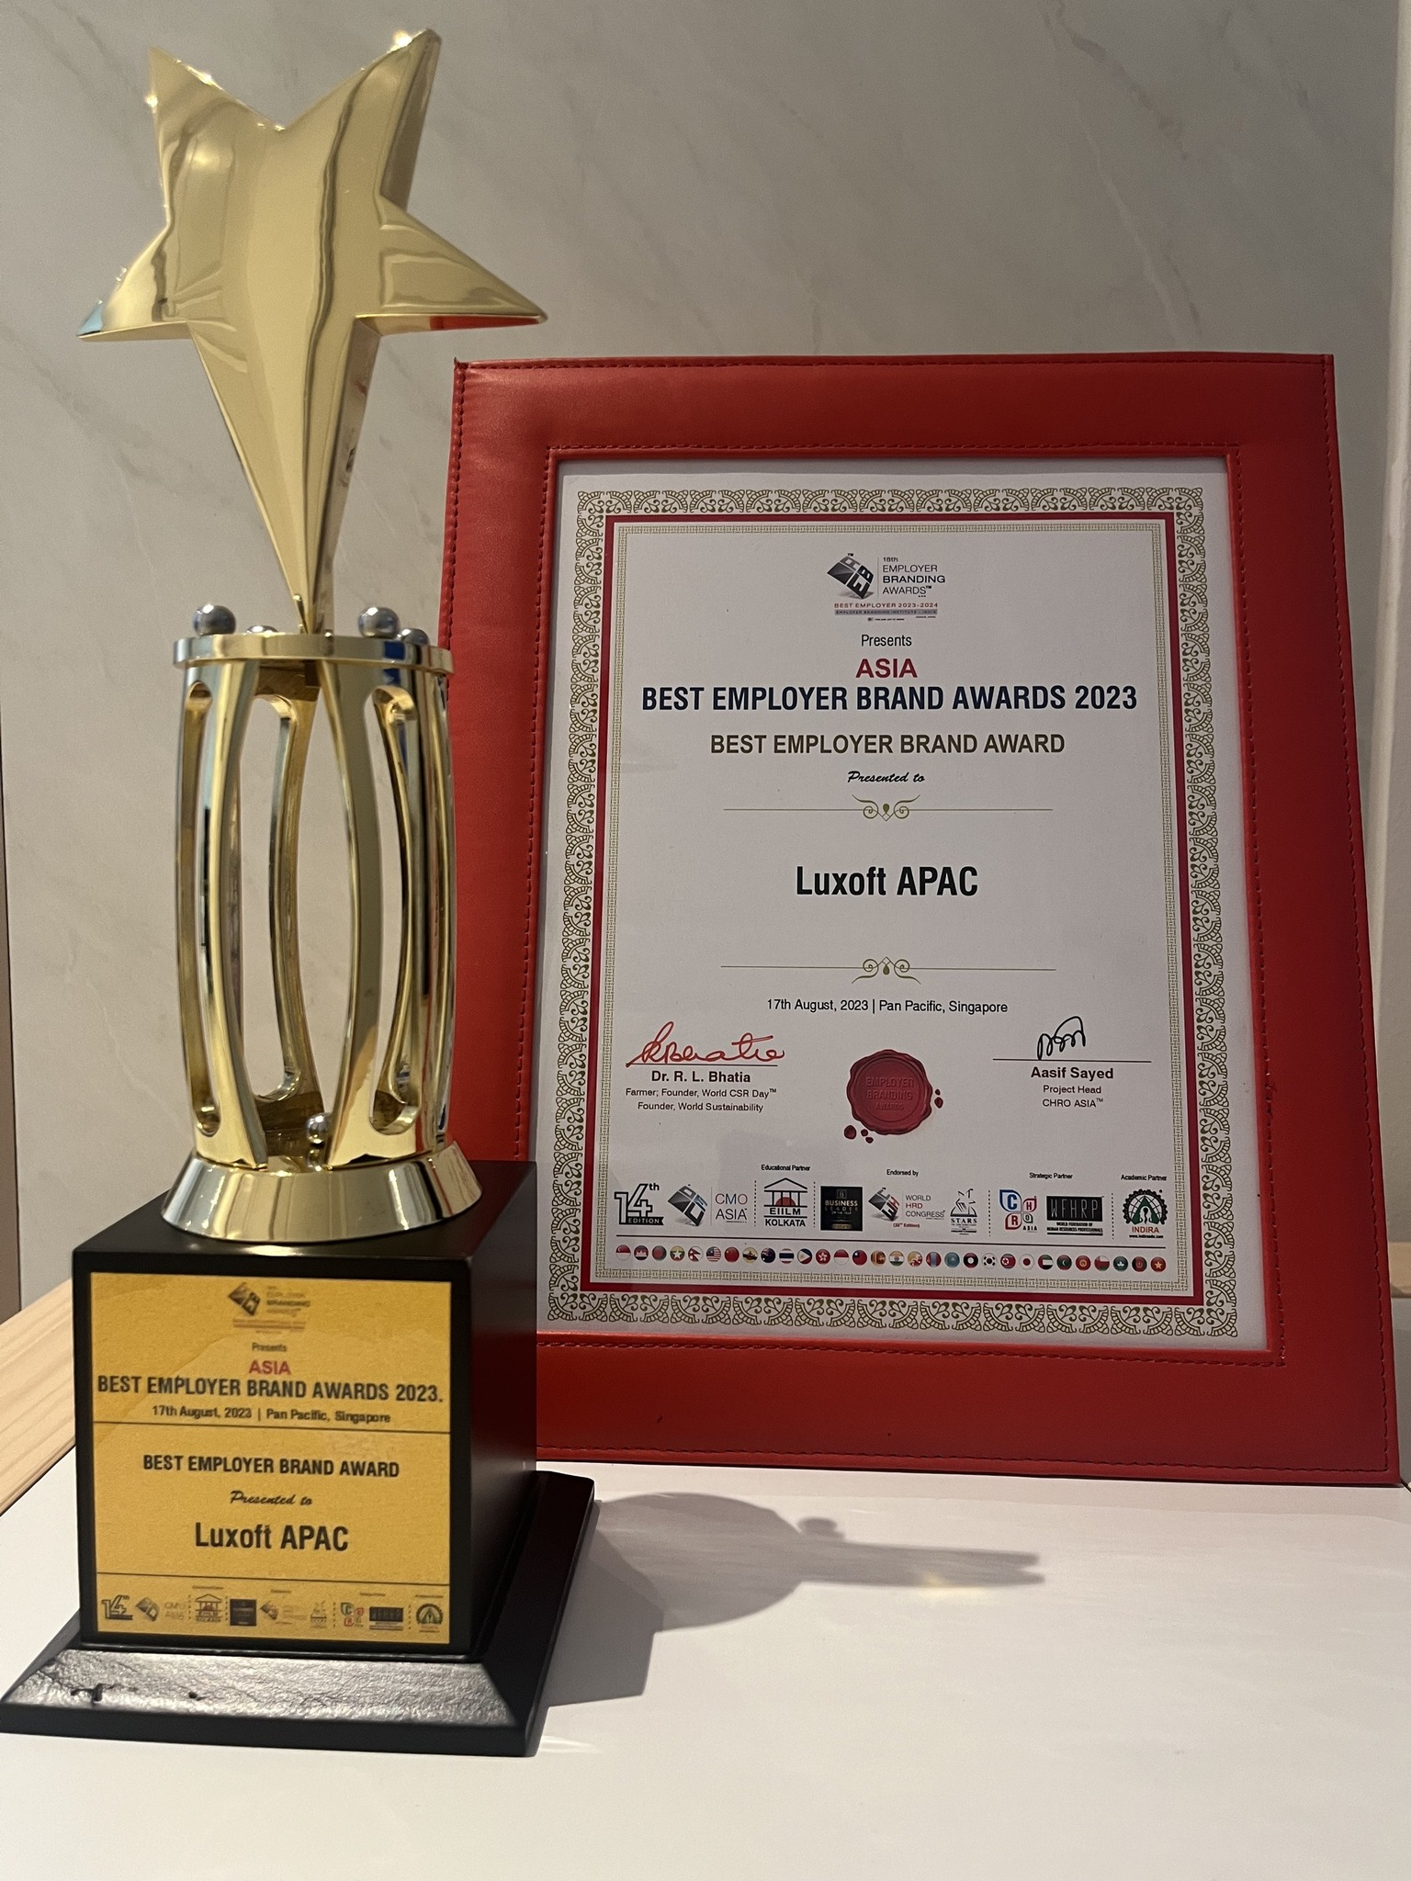



Luxoft APAC – Best Employer Brand & GPTW® Certified in 2024
Celebraring our High-Trust High-Performance Culture TM
Luxoft APAC is the Best Employer Brand 2023 recognized by HRM Asia

Slide 14
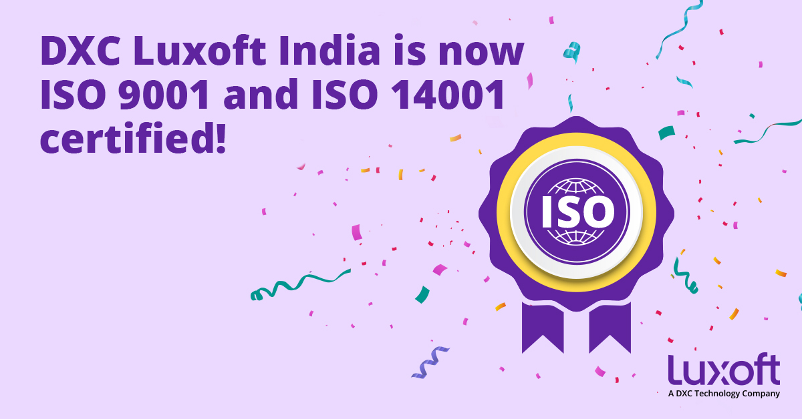
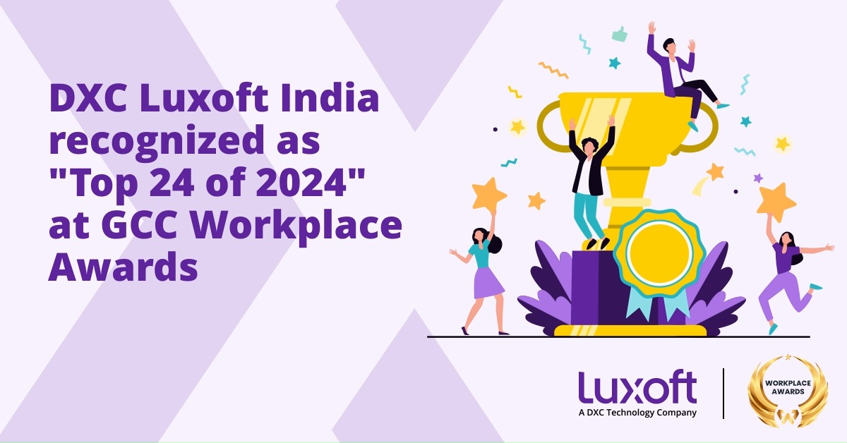
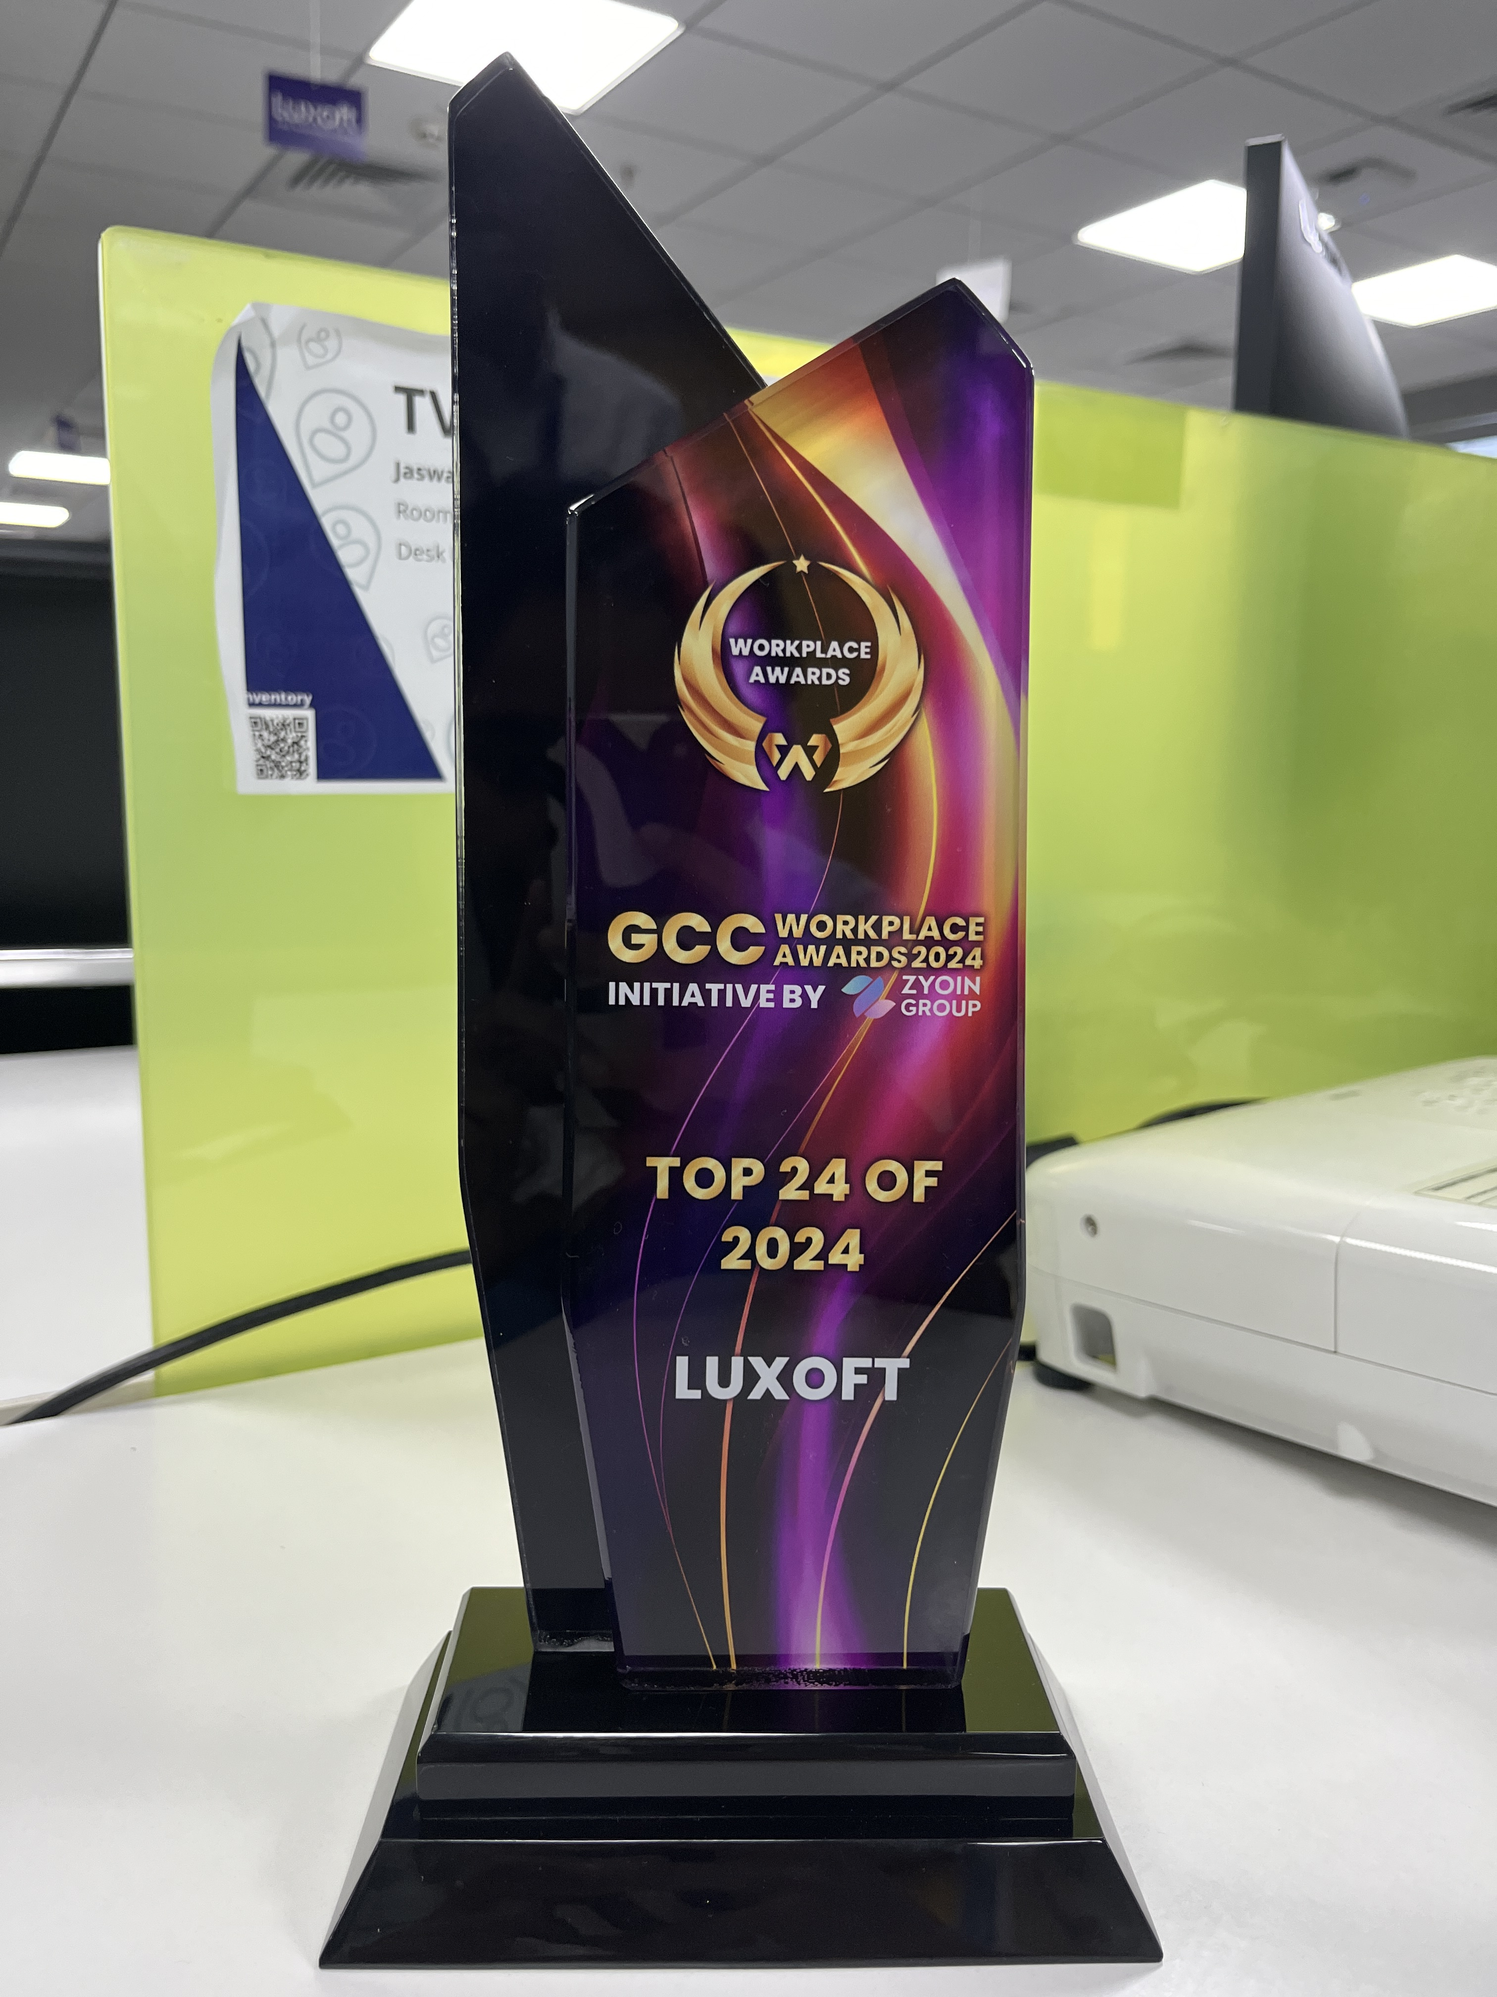
Luxoft India: Certification & Awards
Luxoft India is now ISO 9001 and ISO 14001 certified,
& is recognized as "Top 24 of 2024" at the GCC workplace awards!

Slide 15

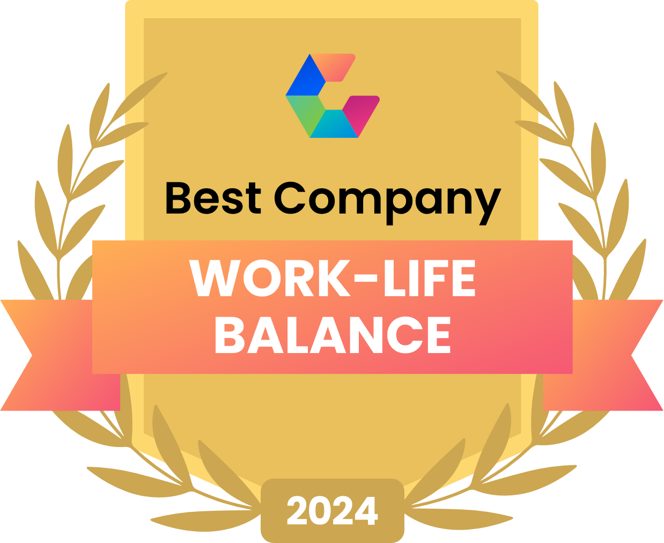

Luxoft global- Awards and Achievements
Luxoft wins WomenTech community’s Gold in Diversity & Inclusion Employer of the Year award 2023
Luxoft is the winner in Comparably’ s “Best Work-life balance” & “Best global culture” categories for 2024.

Slide 16
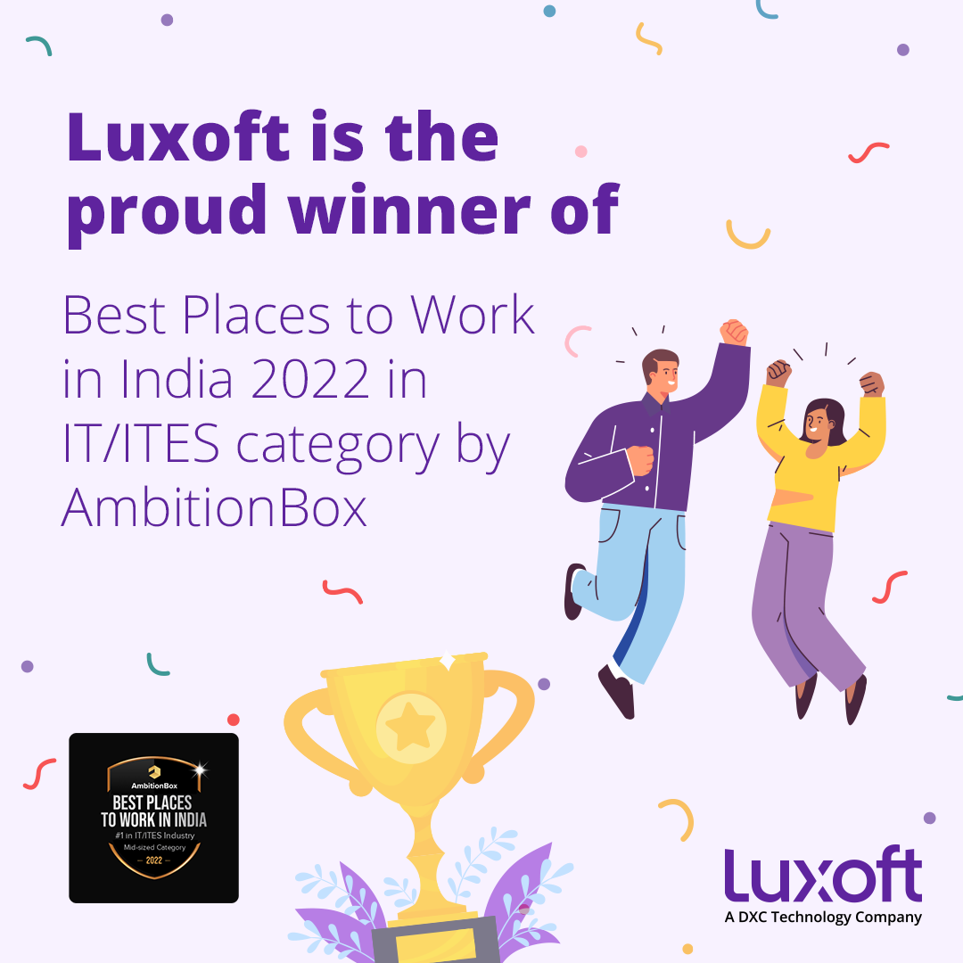
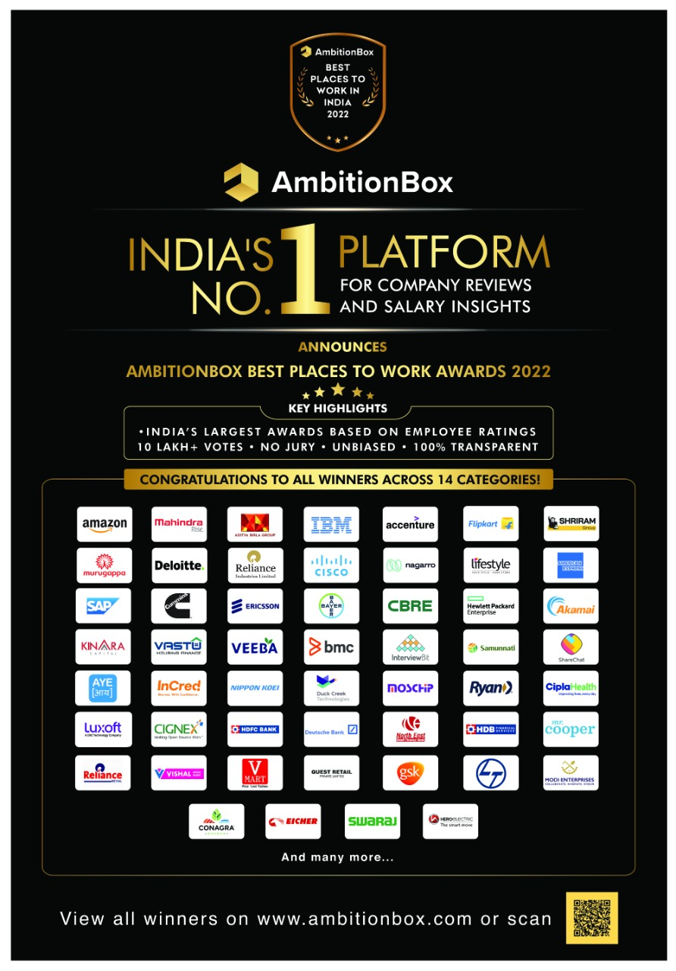
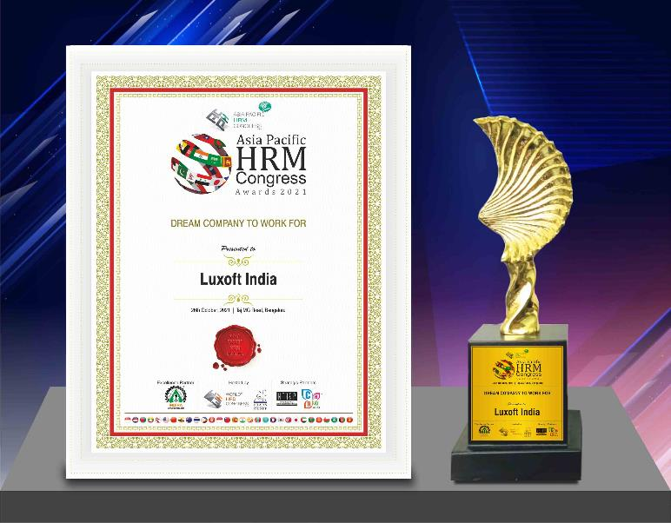
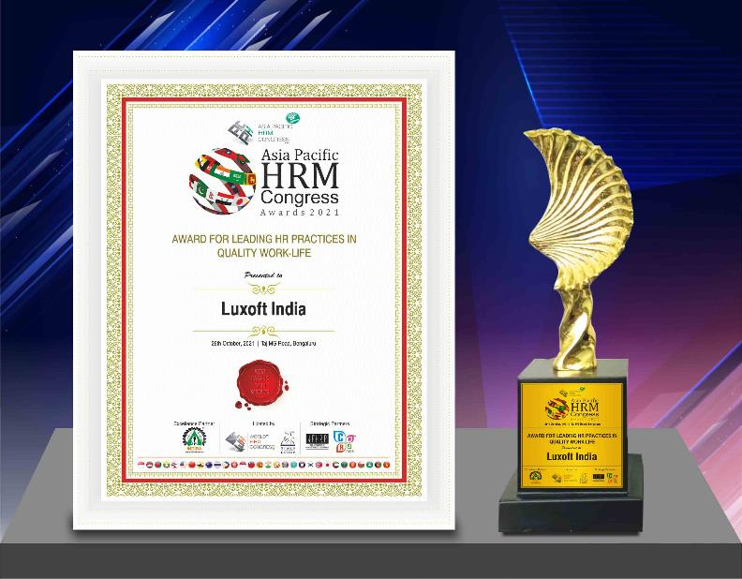
Luxoft India - Recognitions
AmbitionBox award for
"The Best Places to Work in India" in IT/ITES category
Asia Pacific HRM Awards for “Dream Company to Work” and “Leading HR Practices for Quality Work Life”
World HRD Congress for
“National Best Employer Brands 2021”

